Slide 1
KTM ANDROID APPLICATION
Team name:KTM
College:fr.Conceicao Rodrigues College of Engineering
Team Members:
Tejas Ghalsasi
Kadambari Saksena
Madhuri Gite

Slide 2
TECHNOLOGY USED:
Front End:
Android , application compatible for android versions above 2.3.x.
Backend:
Remote MySQL server. Conntected using a php file which is triggered by android app,

Slide 3
INNOVATION
File Encryption
We use SHA-256 ALGORITHM FOR ENCRYPTION OF ANY USER DATA.
Registering concept:
We have followed that every person who registers through the app ,also registers his phone along, hence all the bills are stored in txt files which can be retrieved and read by the user.
Sending Emails:
The user can send emails for refund or to dispatch any query .this email is sent to the developer.

Slide 4
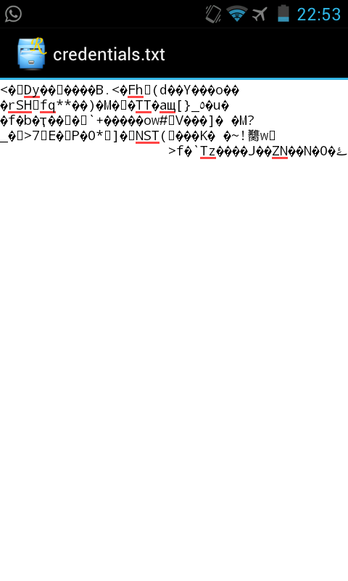
Encryption:

Slide 5
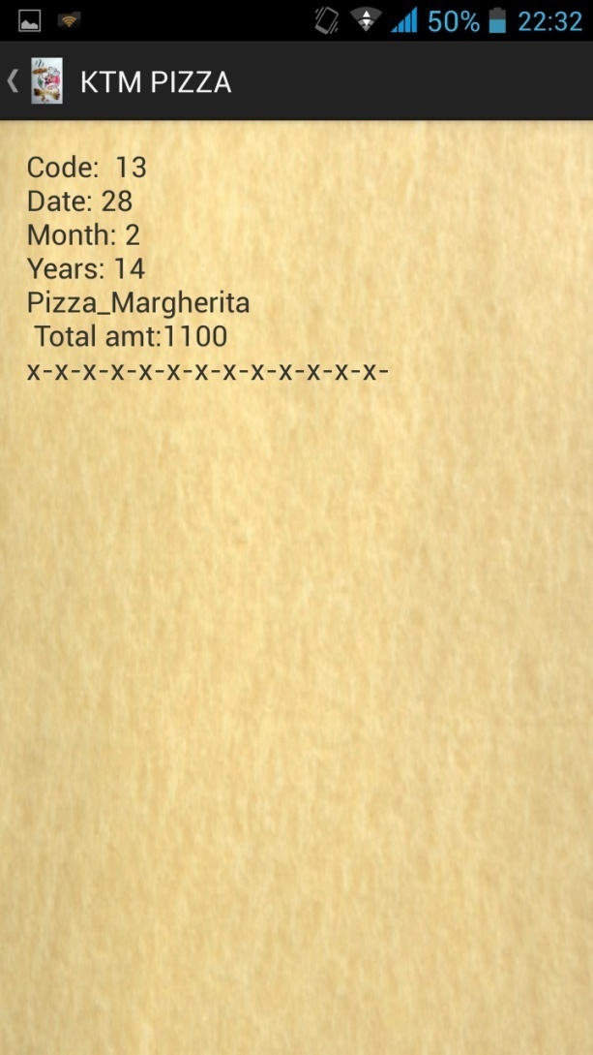
Bills:

Slide 6
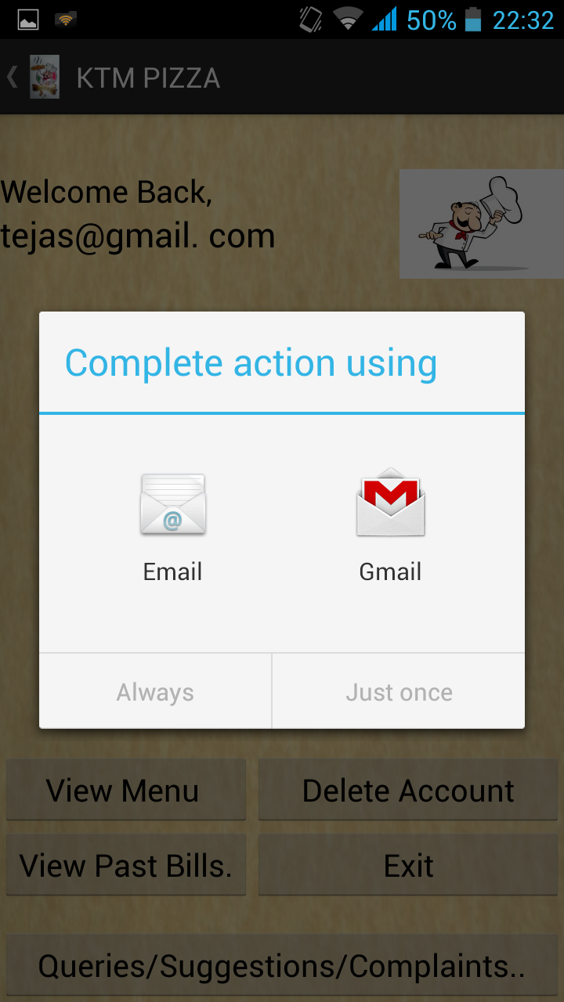
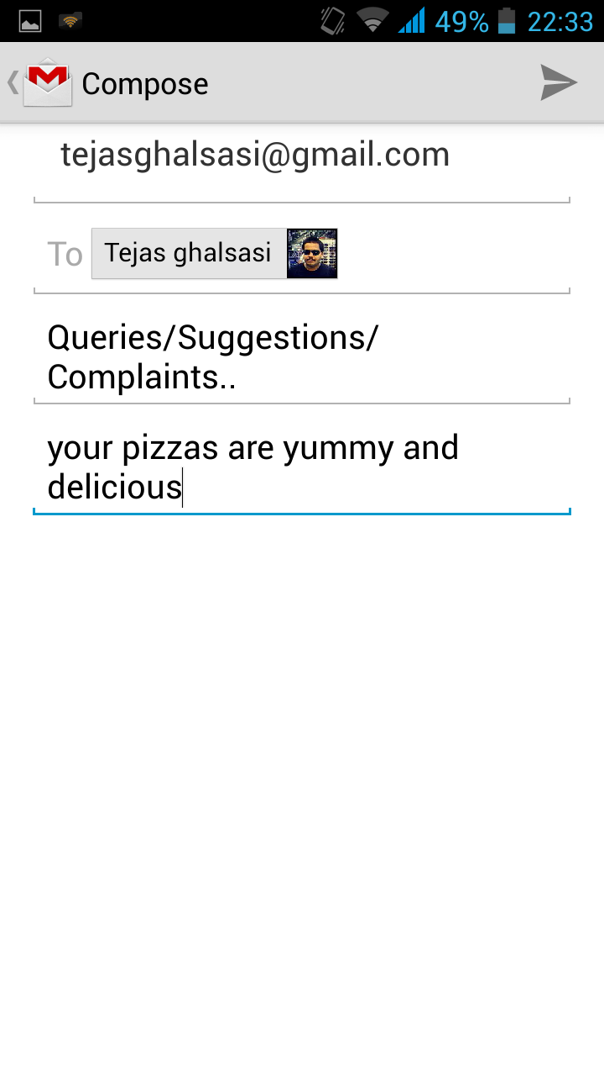
Sending Emails:

